Slide 1
Terby Crater: A Look Into Mars’ Mineralogy
Shaye Fordring, Jennifer Buz, Christopher Edwards

Slide 2
Motivation:
What is a basin?
Basins have an incredible geologic importance, studying basins allows us to:
Determine material diversity
Across the basin, and in layers
Unlock clues to Mars’ early climate
Question:
How does mineralogy and grain size distribution change across a paleolake basin?

Slide 3
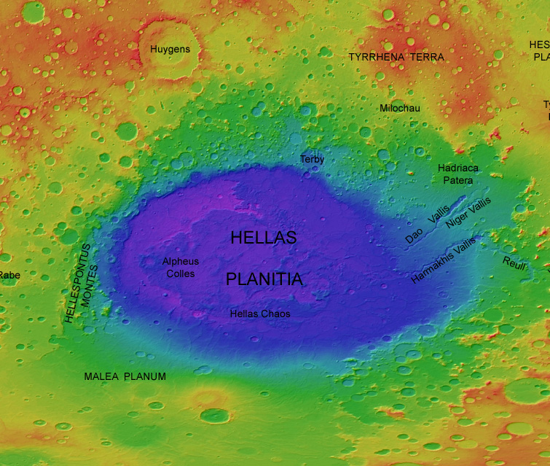
Methods
CRISM Analysis: JMARS/ENVI
Compact Reconnaissance Imaging Spectrometer for Mars – visible and infrared detectors map mineral residue
Remote sensing spectroscopy (VNIR/IR)
VNIR combines both IR and the visible spectrum up to the water absorption band (1400nm-1900nm)
USGS

Slide 4
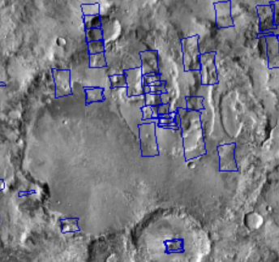
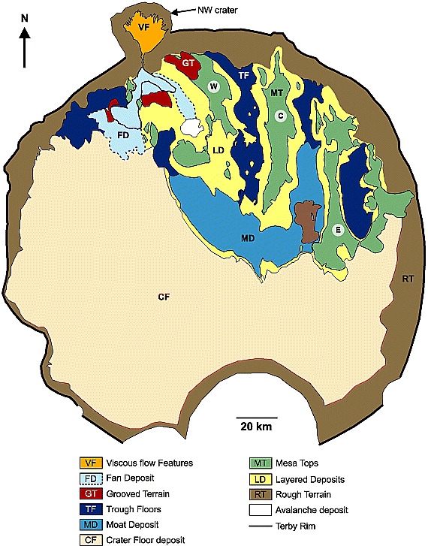
Terby Crater 28S, 74E
Minerals Present:
Pyroxenes, Clays
Mafic Minerals
Hydrated minerals, Fe/Mg phyllosilicates (MT)
CRISM stamp photo captured from JMARS program
Wilson, et al. 2007

Slide 5
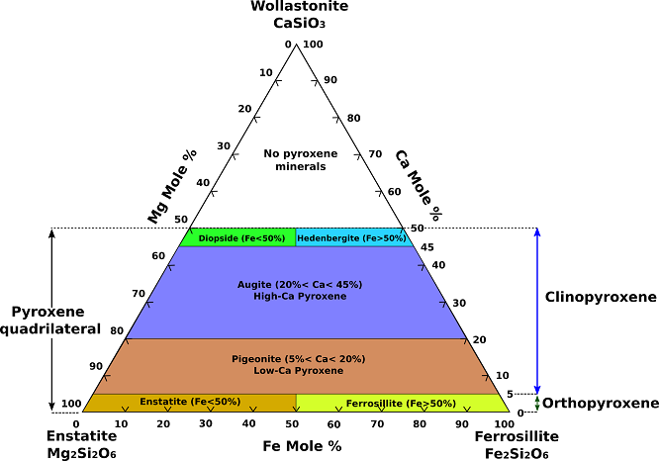
Terby: CRISM Results
Pyroxene Model
Alex Strekeisen

Slide 6
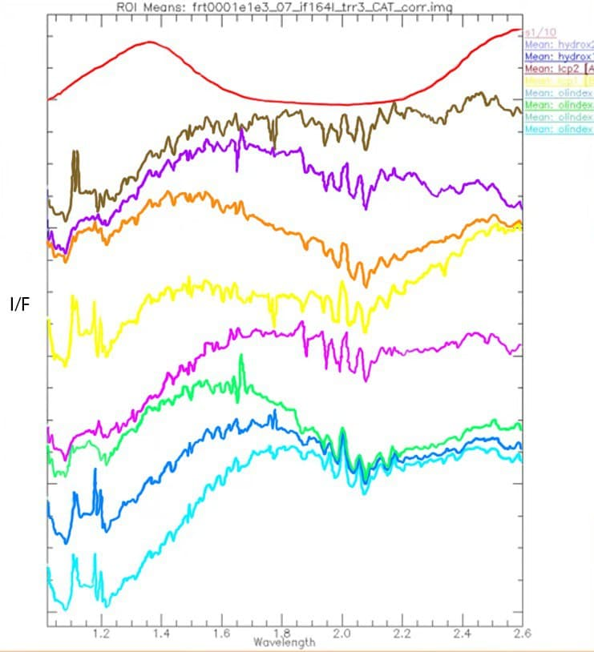
Enstatite Library Spectra
Saponite
Enstatite

Slide 7
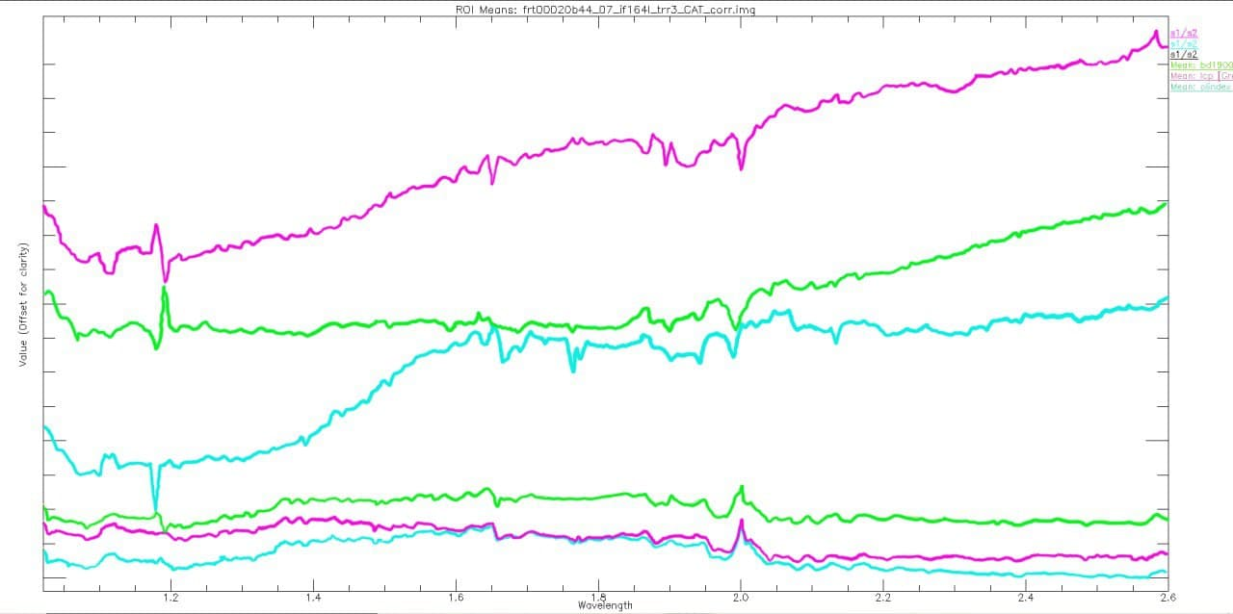
Terby: CRISM Results
Ratioed Spectra: Olivine
LCP (Low Calcium Pyroxene)
BD 1900 (Water Absorption)
OIivine

Slide 8
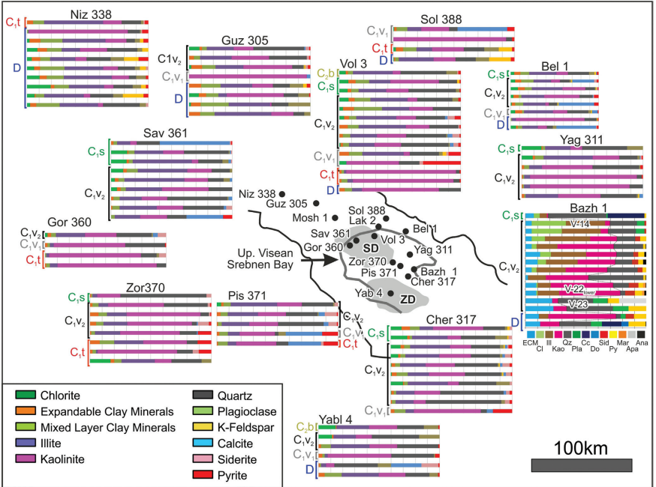
CRISM: Relating Martian and Terrestrial Craters

Slide 9
Questions
Acknowledgements: Mentors: Jennifer Buz, Christopher Edwards Northern Arizona University NASA Space Grand Coordinator: Paloma Davison NASA Space Grant Program Northern Arizona University Department of Physics and Planetary Sciences
Thank you for watching!

